Slide 1
G2M Investment Case Study
Virtual Internship
Chow Jun Wei
26 Oct 2021

Slide 2
Goal
To understand the market before deciding on investing in Cab industry, and which to invest on.

Slide 3
Some things to note
Data isn’t as mentioned starting from 31st January 2016, but 1st January 2016. (found mismatch between number of days between expected and actual).
One city (San Francisco) is missing from Cab_Data.csv, resulting in inconsistencies with other csv files.
Profit per km is not fix, perhaps due to waiting times. There also exist negative profit per km, when price charged is less than cost of travel.
We would only investigate those analysis important towards the goal.

Slide 4
Is the Cab Industry even worth investing on?
It is, IF you include Uber, Lyft, also as Cab Industry. Generally nowadays these noted companies are replacing general Taxi and Limousine.
According to Statista [1], Revenue growth continues rising until Covid Outbreak. Afterwards, it is expected to grow when economy heals.
Allied Market Research [2] also expects revenue growth and mentioned ride-hailing and ride-sharing services (Uber, Lyft, etc) increase in demands.
Notes:
Note: When one accesses Statista, the General Revenue data are still available. Currently it is no longer available.

Slide 5
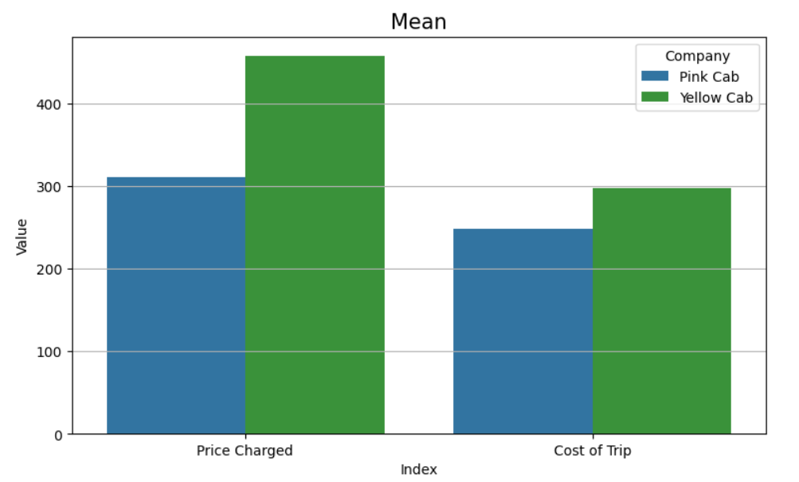
Mean price charged for Yellow Cab is higher than Pink Cab

Slide 6
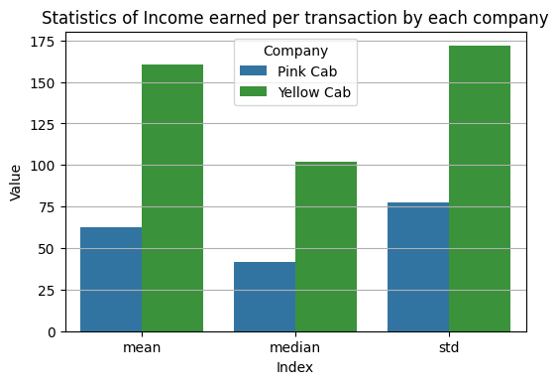
Mean Income is hence higher for Yellow Cab

Slide 7
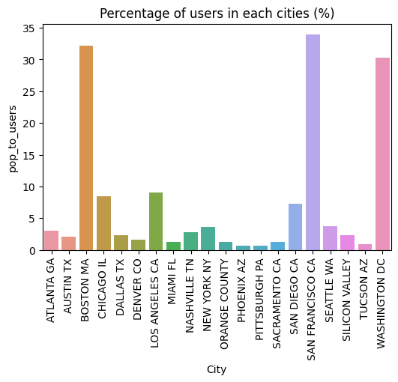
Some cities have more percentage of users than others

Slide 8
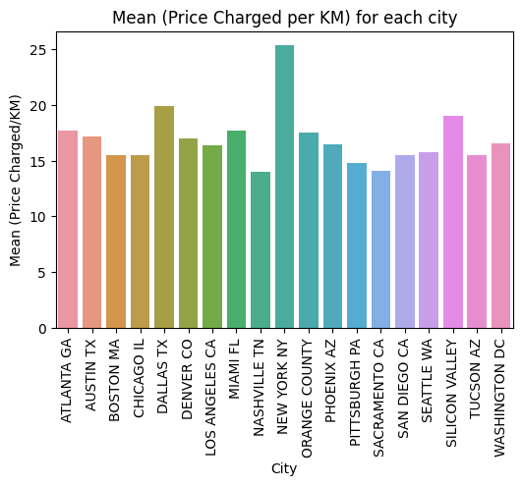
Most city have approximately equal price charged, though higher for New York

Slide 9
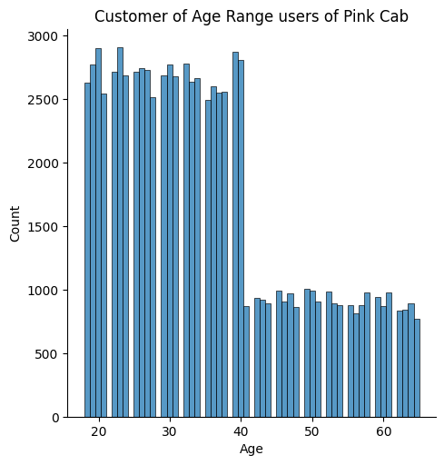
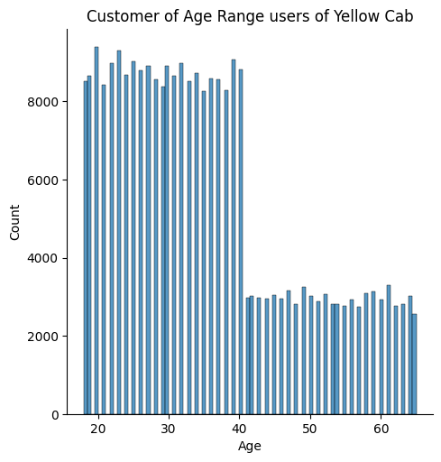
Customers for the survey are taken from younger age range

Slide 10
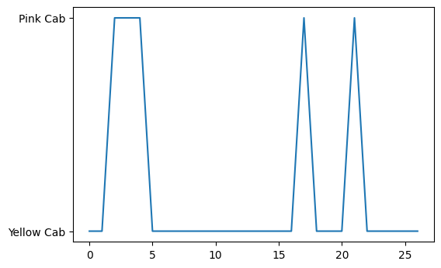
Consecutive ride retention means how many consecutive rides the customer stays using a cab, not the total count per cab per customer.
Notes:
Consecutive ride retention: how was it considered? Requires explanation.

Slide 11
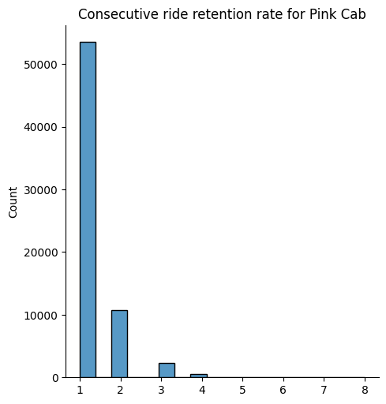
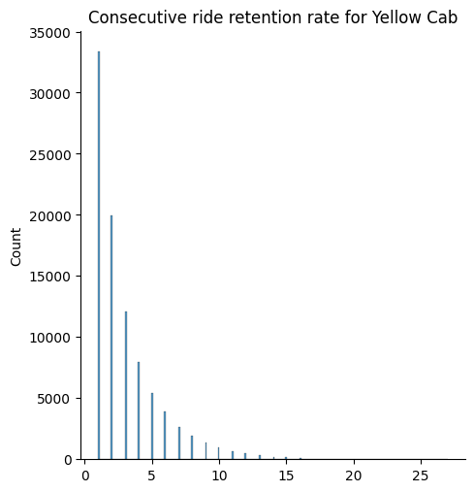
The result is Yellow Cab gets higher retention rate than Pink Cab, hence better for investment between the two.

Slide 12
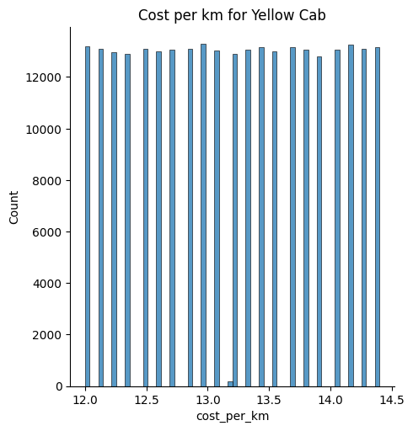
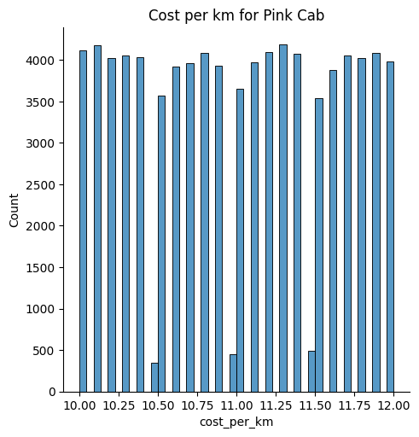
Cost per km is lower for Pink Cab than Yellow Cab. Perhaps Yellow Cab has larger and more luxury vehicles.

Slide 13
References
https://www.statista.com/outlook/mmo/mobility-services/ride-hailing-taxi/united-states
https://www.statista.com/forecasts/409678/taxi-service-revenue-in-the-us
https://www.alliedmarketresearch.com/taxi-market-A10565

